Slide 1
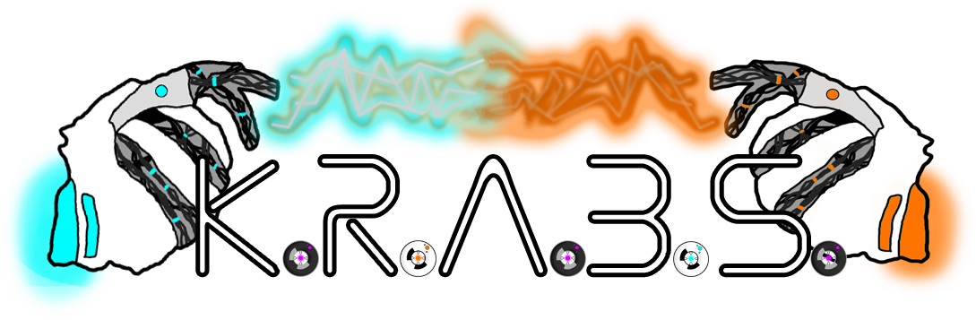
Group 8 – Gold Pitch
Design Masterclass – Bandai Namco Brief
Max Carter & Rebecca Brannum

Slide 2


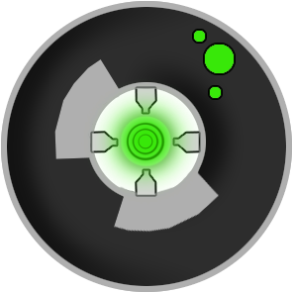

What is K.R.A.B.S?
Game we created for Ludum Dare 38
2D, 2 player, single screen
Simultaneous, symmetrical play
Resource gathering and battling
Aimed at males 12-17
Notes:
Single screen 2 players 2D Simultaneous, symmetrical play Resource gathering + battling Currently just 1 level

Slide 3
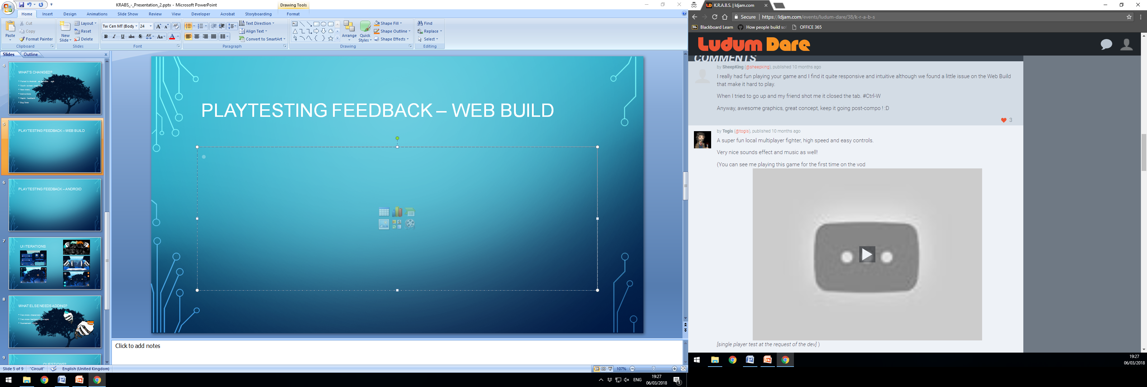
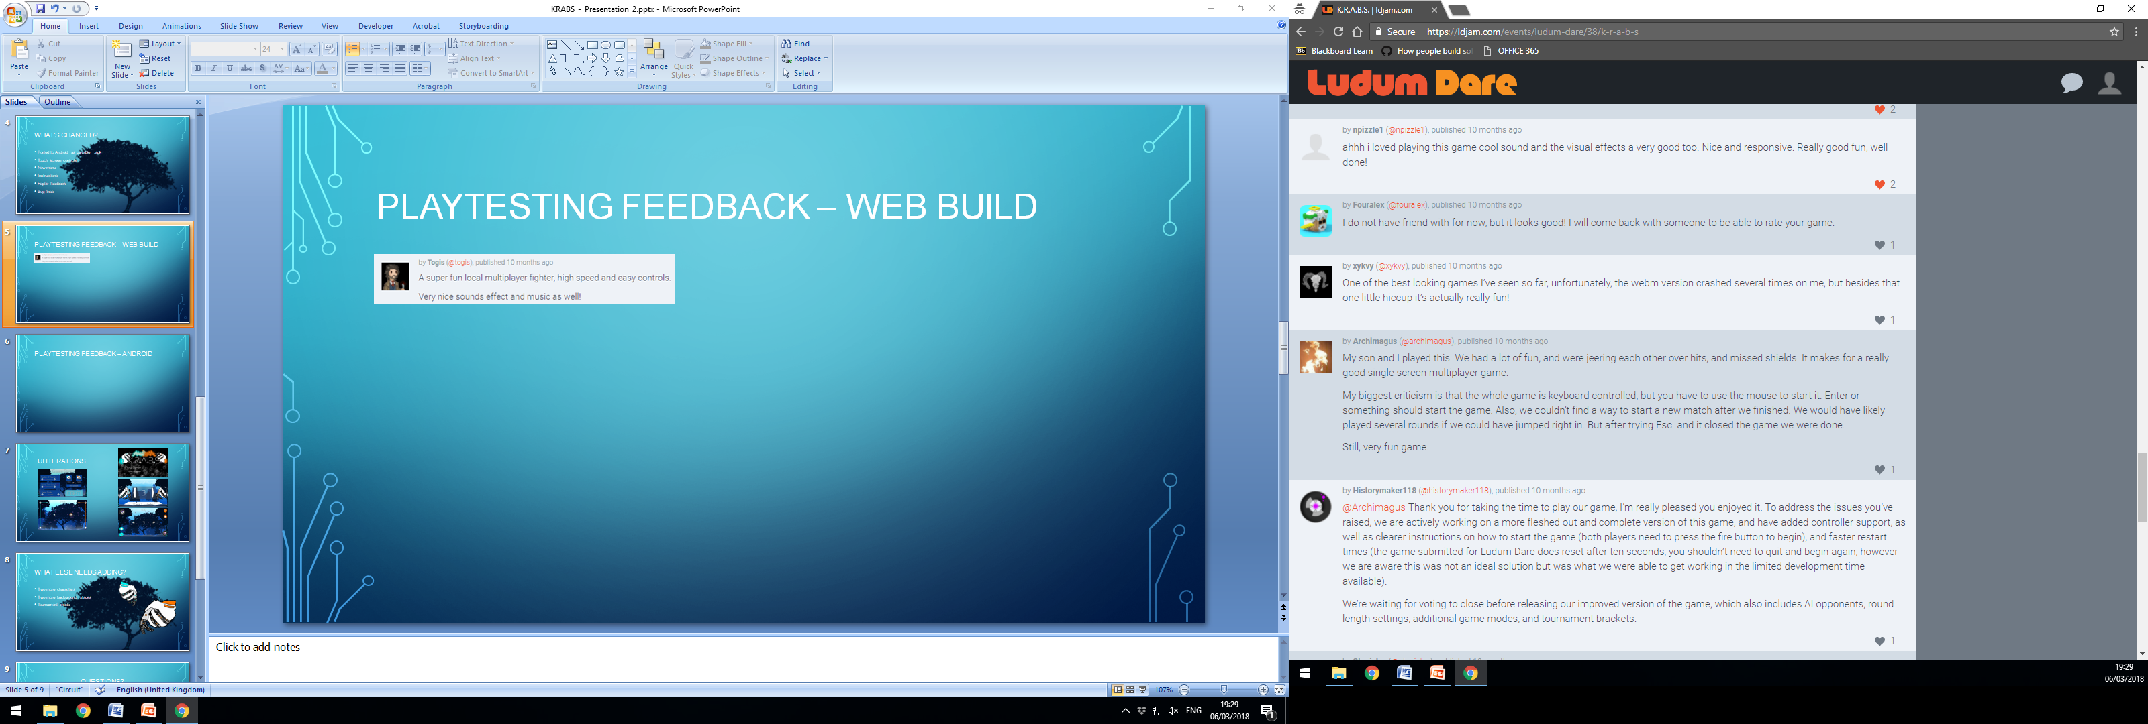
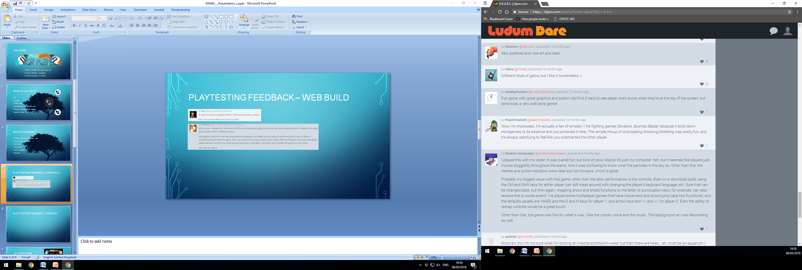
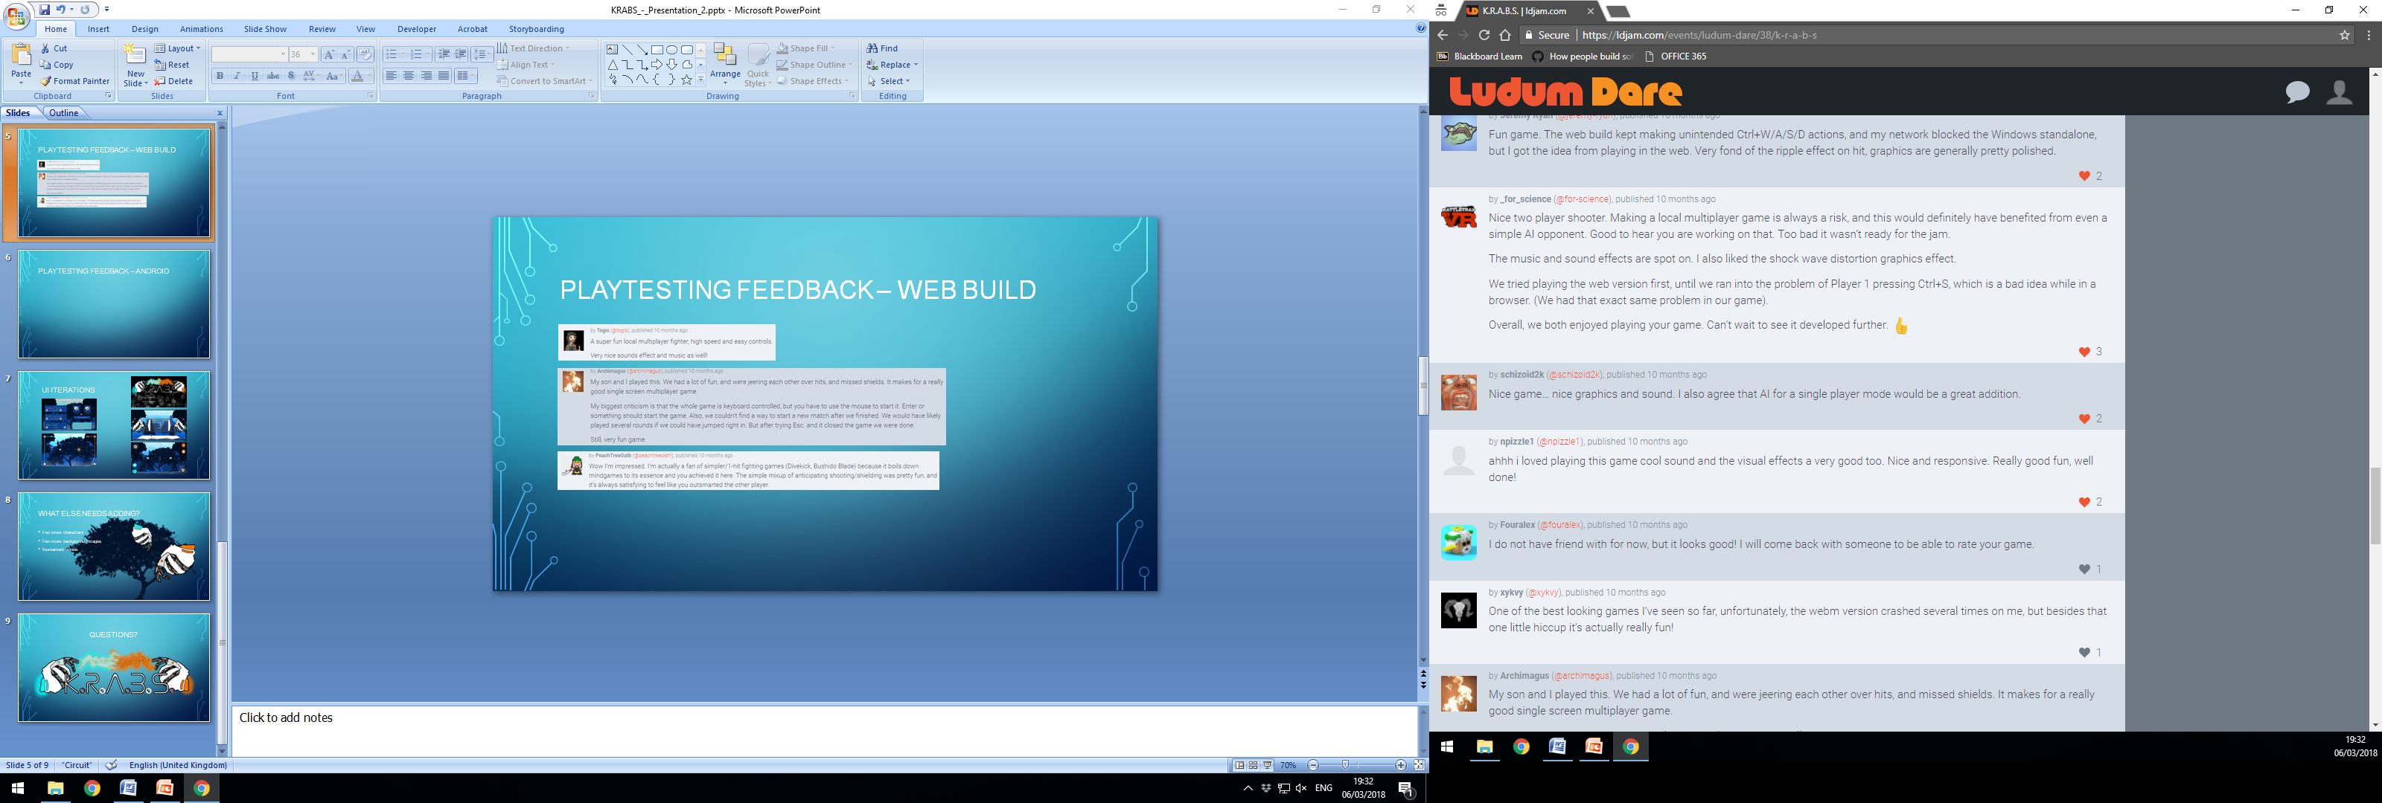
Playtesting Feedback – Ludum Dare

Slide 4
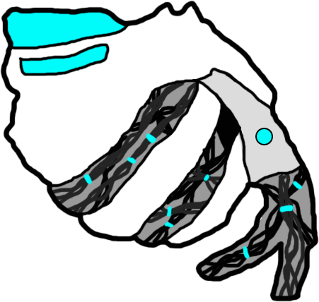
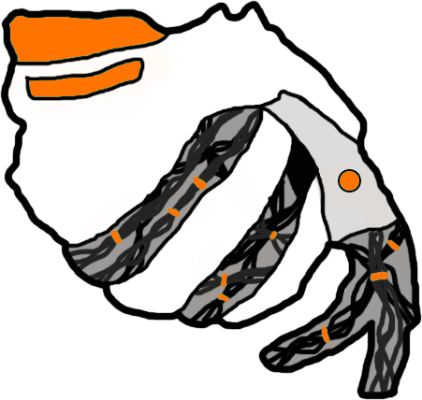
Playtesting Feedback – Web Build
Collectables are a bit small
Colour contrast issues
Acceleration inconsistencies
“Predicting bullets and shielding was really satisfying”
“I loved beating my friend at the last second”

Slide 5

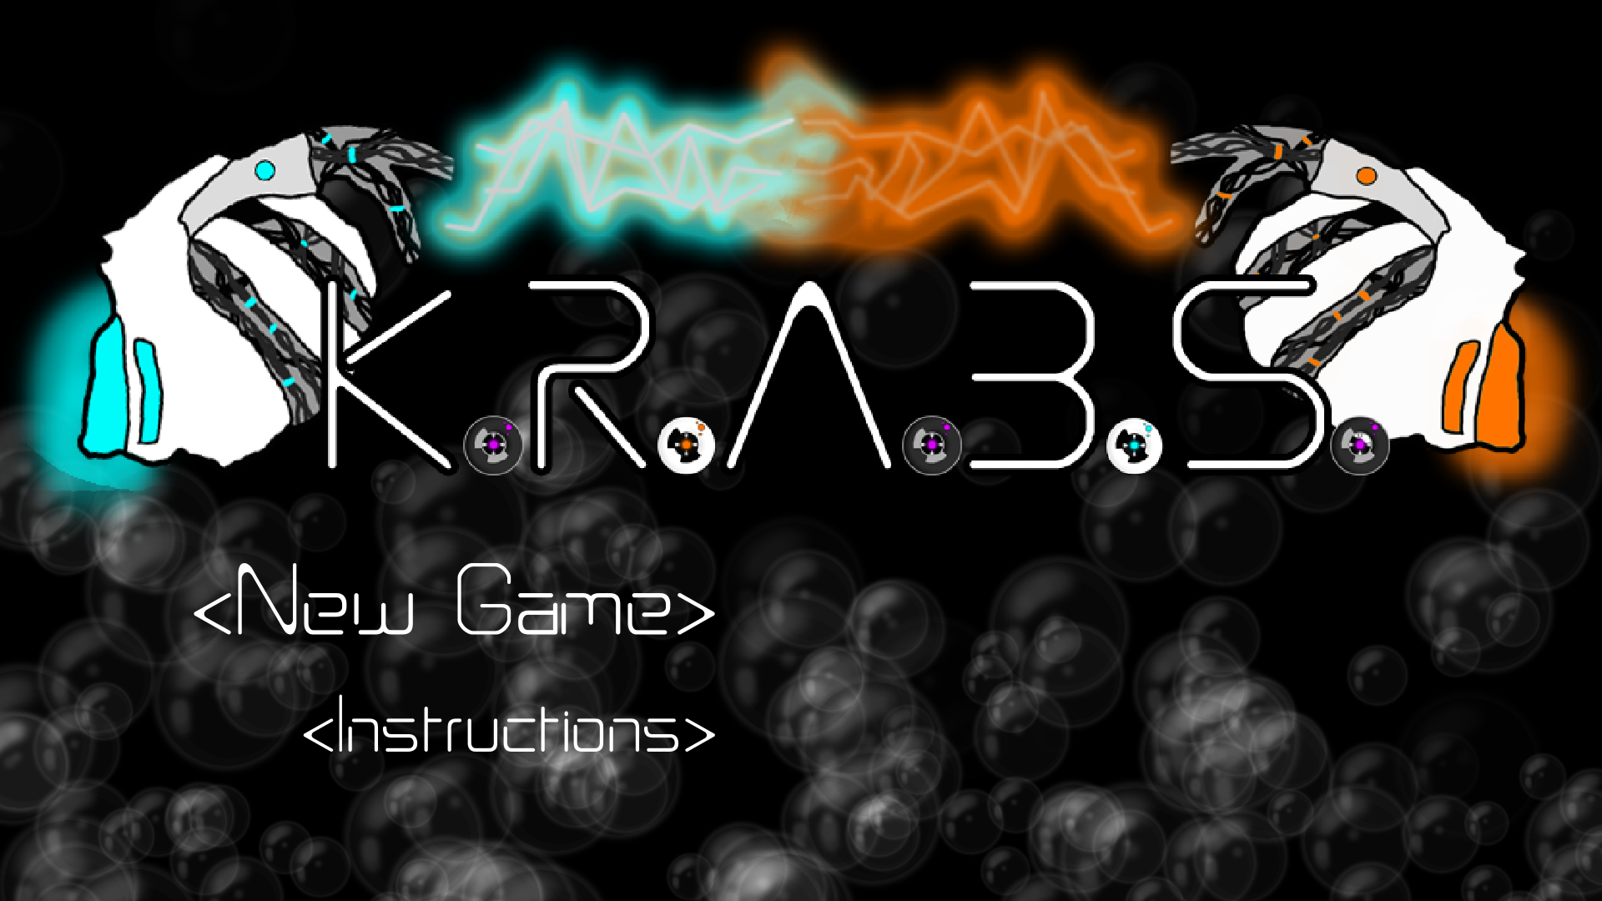
Playtesting Feedback – android
Pre-Joystick Iterations
Tap and drag movement - obscured vision, lost track of character
UI not clear, bars hard to see on small screen
Post-Joystick Iterations
UI is more intuitive
Controls less clunky
Faster gameplay

Slide 6
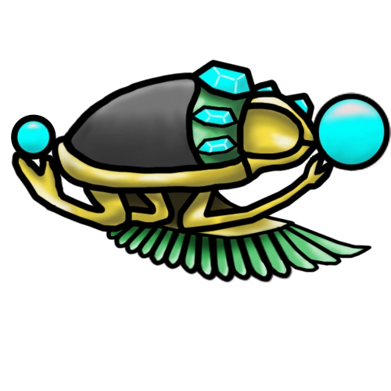
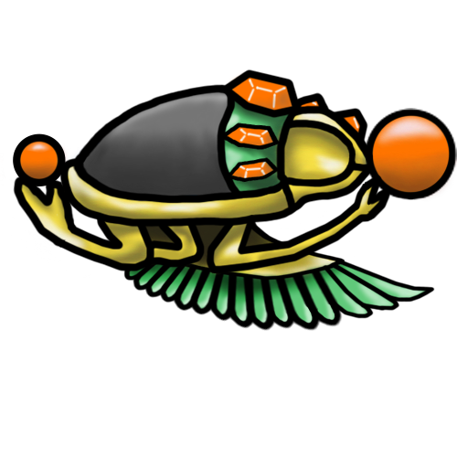
What’s Changed?
New map
New characters
New game mode
Control & UI iterations
Menu iterations
Bug fixes

Slide 7
Gameplay
INSERT VIDEO OR LINK HERE
Notes:
Add additional characters to choose from Animations for characters Stage selection Tournament mode Main menu (options)

Slide 8
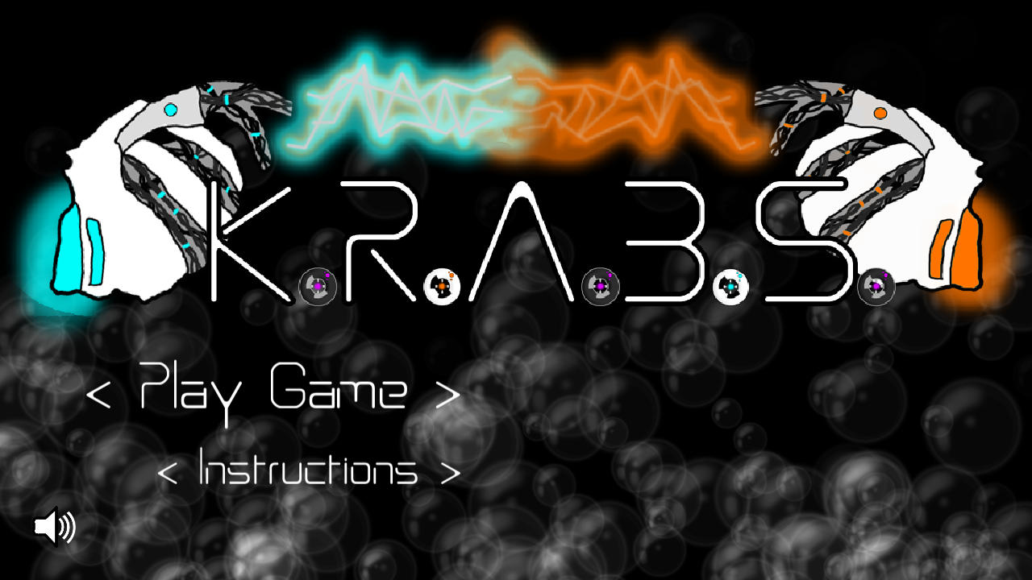
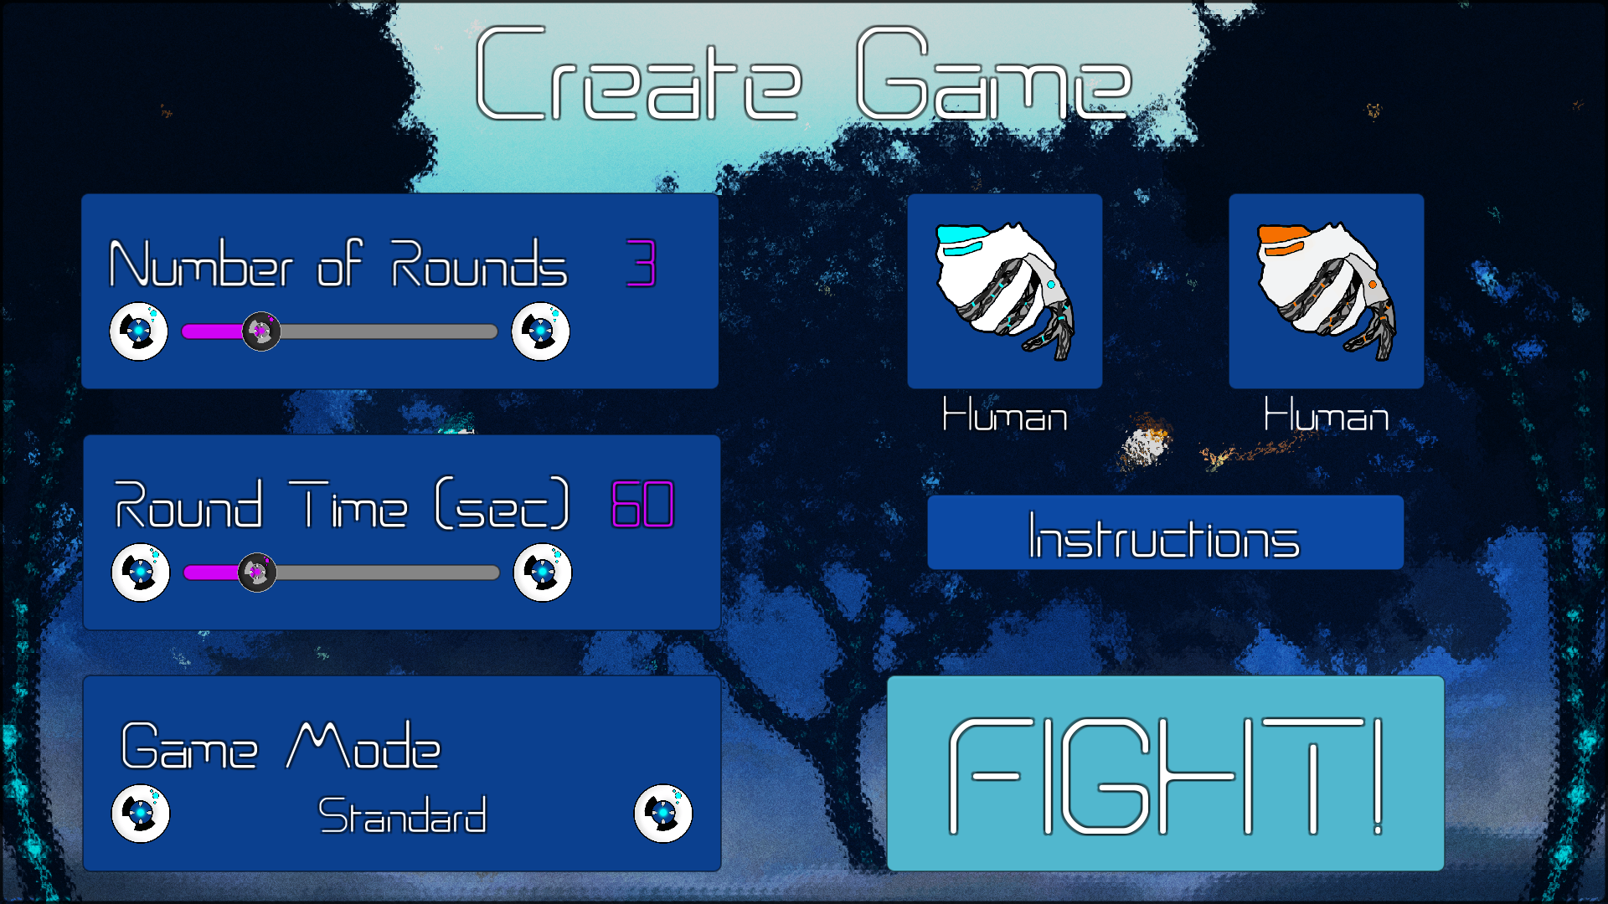
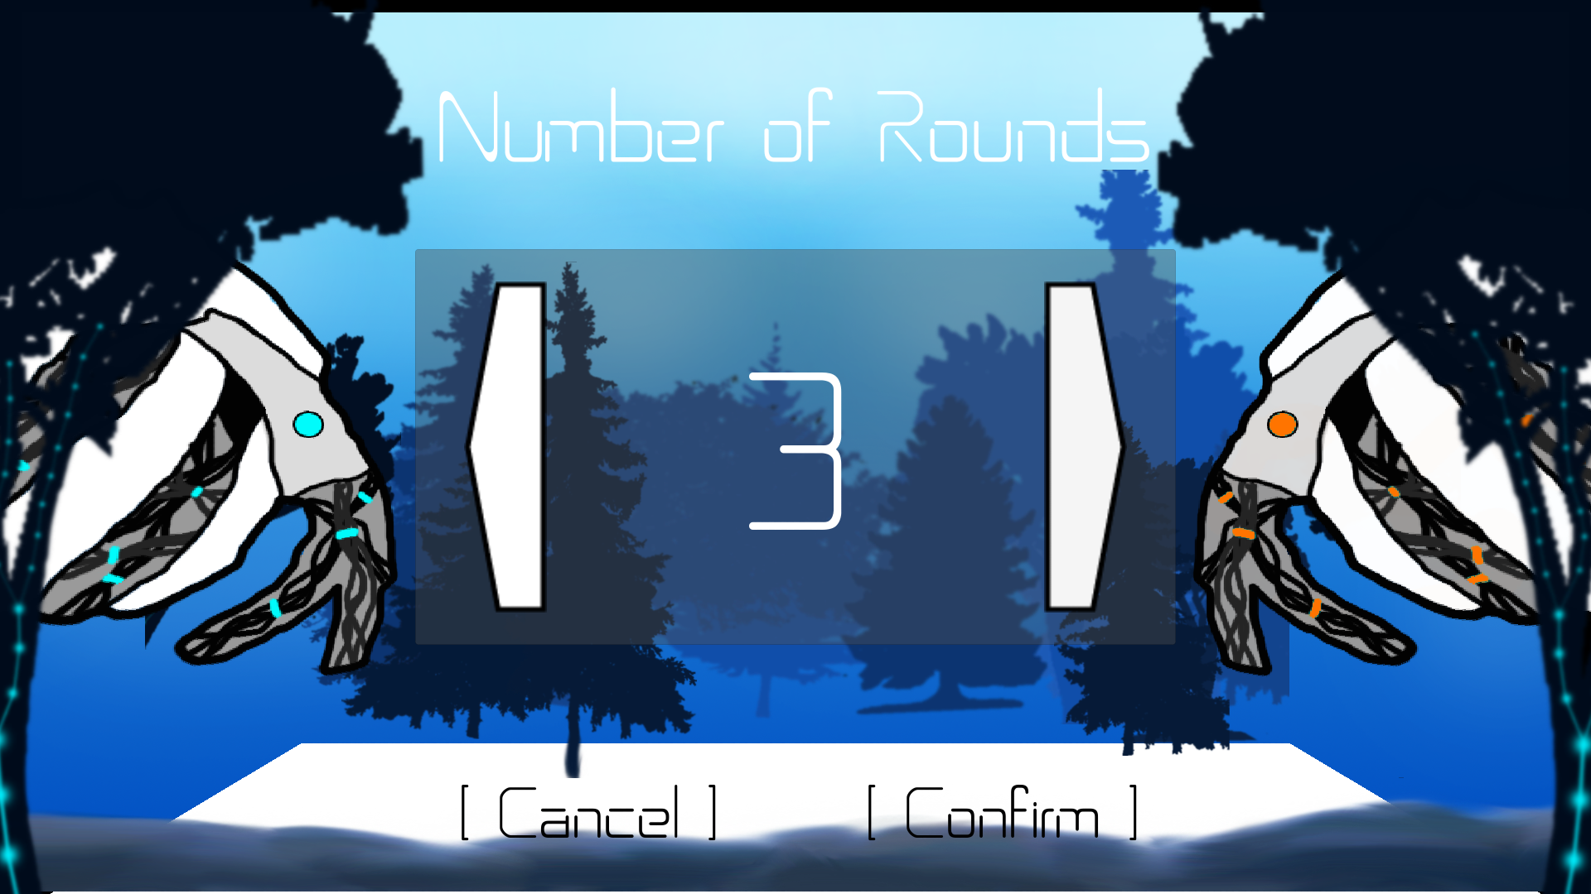
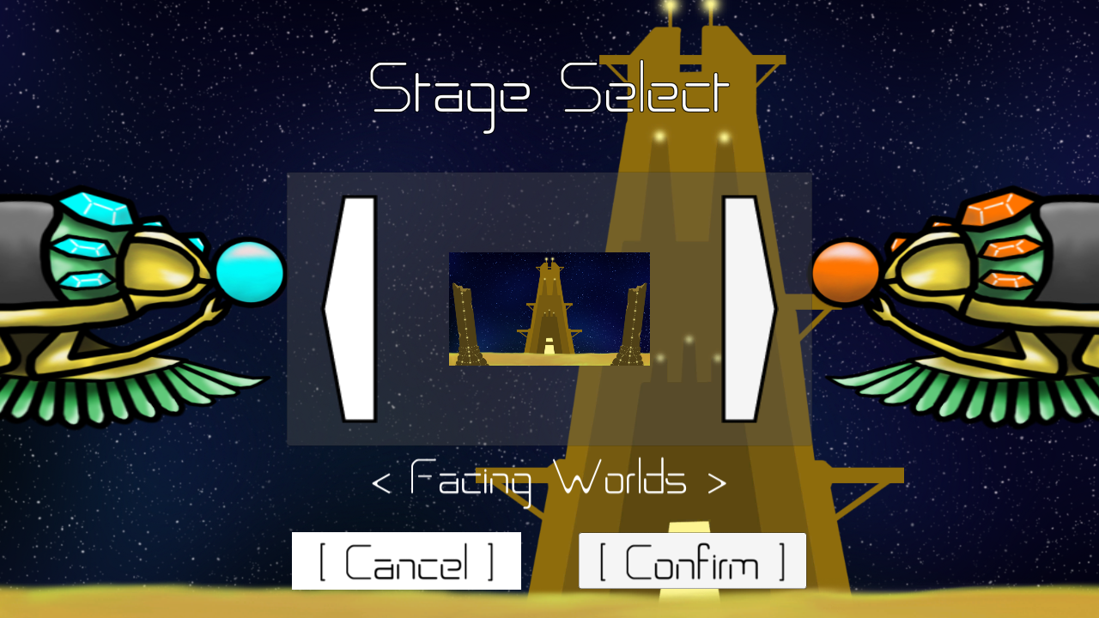
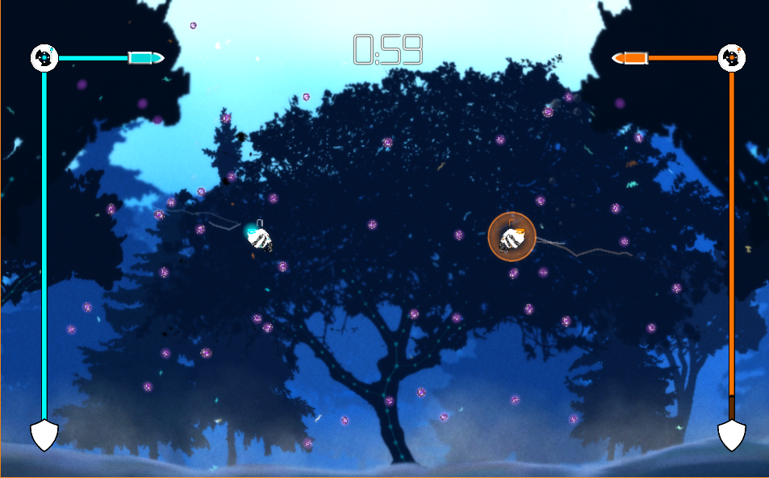
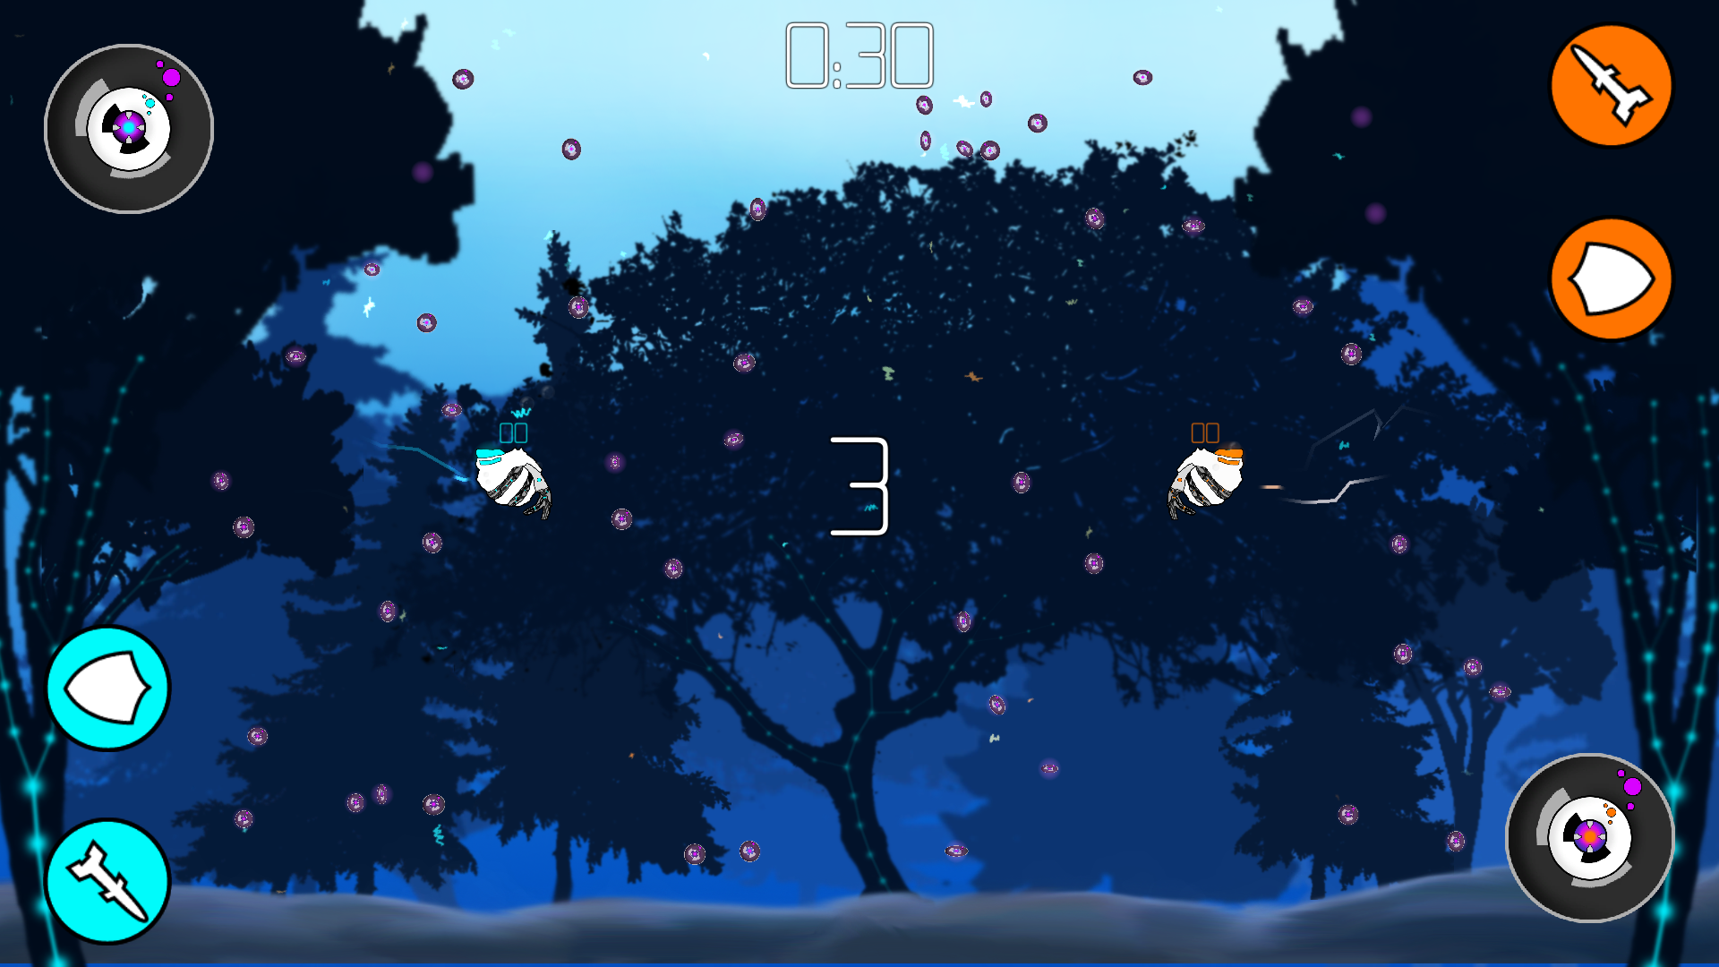
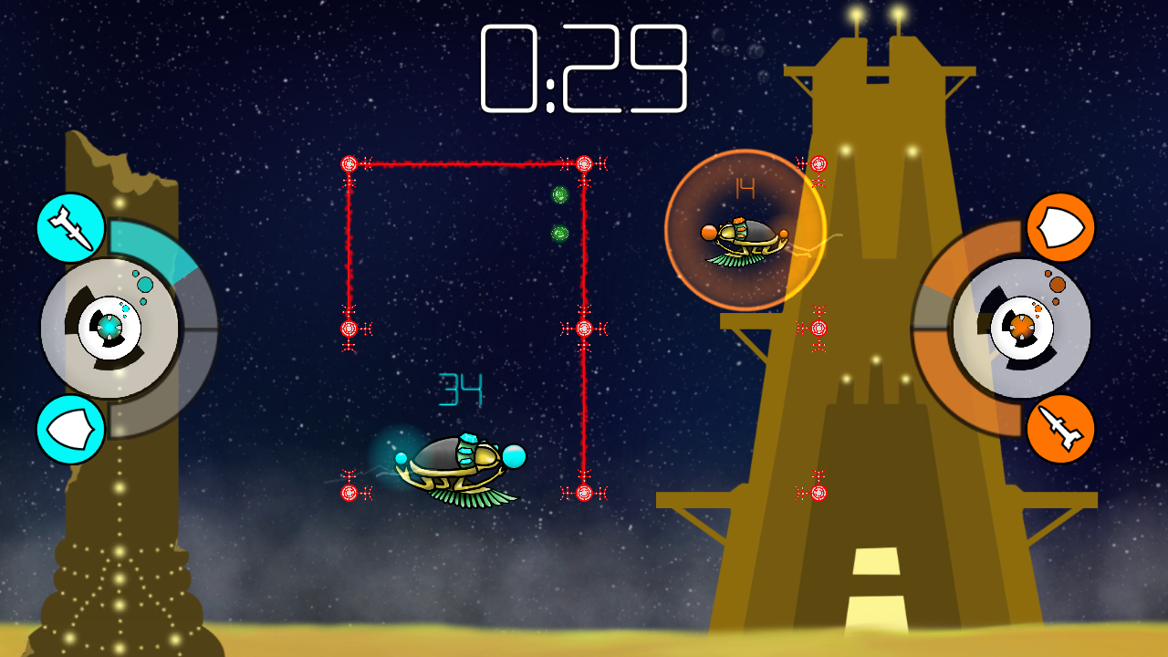
UI Iterations

Slide 9
Control Iterations

Slide 10
Questions?

